Slide 1
Pre-service teacher education and strategies for teaching for diversity and inclusion
Shirley O’Neill
University of Southern Queensland

Slide 2
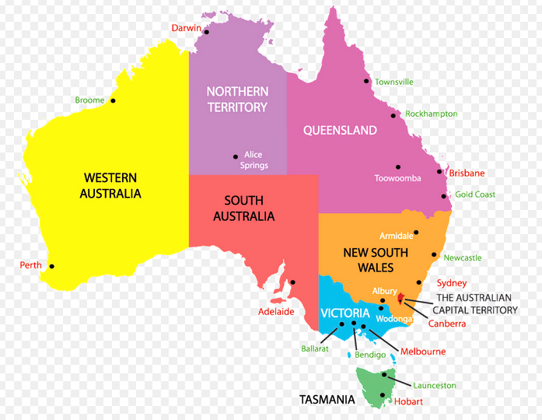
Australian states and territories

Slide 3
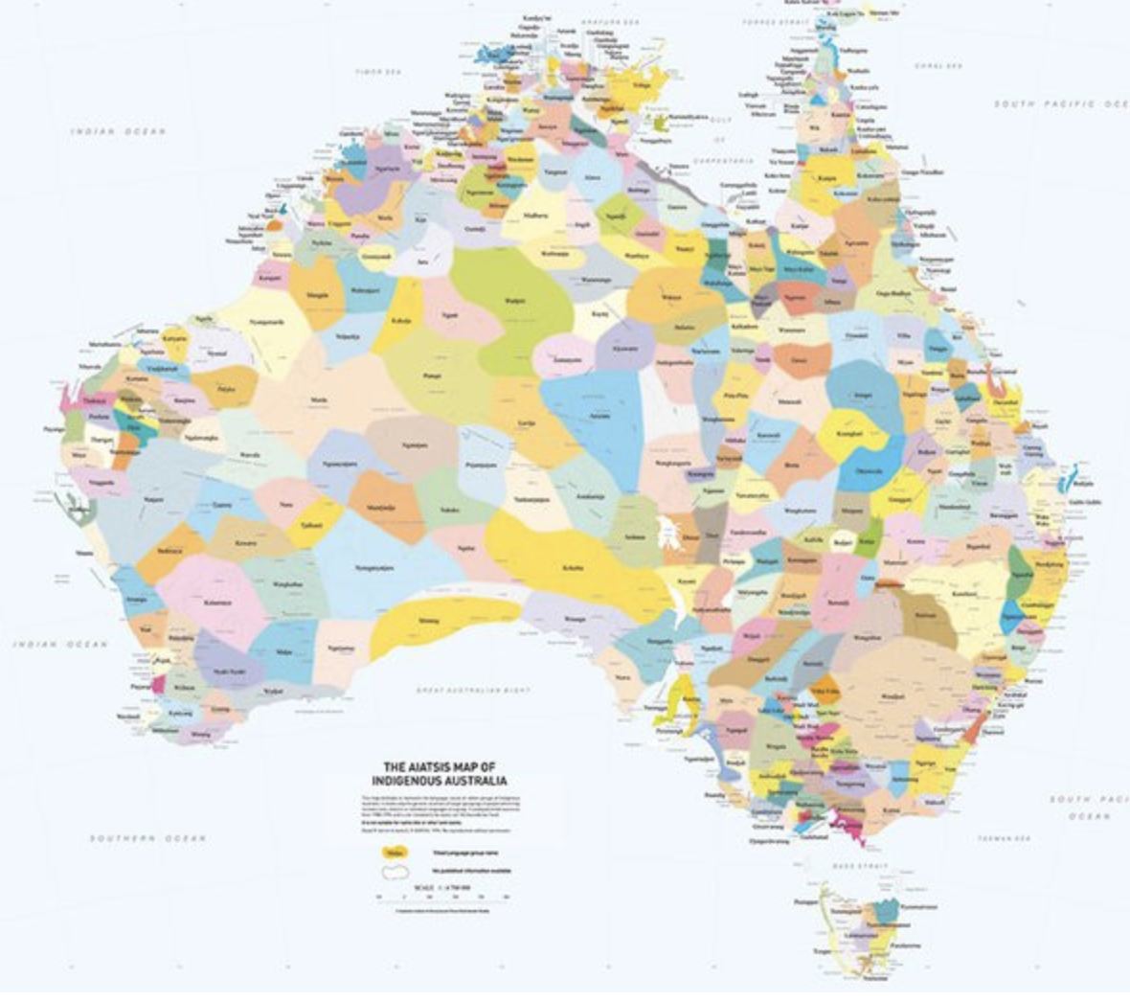
Over 250 First Nations Peoples’ languages and 800 dialects
QUORA, nd
Notes:
“The map is an attempt to represent the language, tribal or nation groups of the Aboriginal peoples of Australia. Aboriginal groups were included on the map based on the published resources available between 1988 and 1994 which determine the cultural, language and trade boundaries and relationships between groups.
The map was developed along with the Encyclopedia of Aboriginal Australia as part of a research project. The Encyclopedia of Aboriginal Australia is available in libraries and contains more detailed information about the groups represented on the map.
The information on which the map is based is contested and may not be agreed to by some traditional custodians. The borders between groups are purposefully represented as slightly blurred. They do not claim to be exact.”
QUORA, nd.
https://www.quora.com/What-would-the-political-map-of-Australia-look-like-if-they-had-never-been-colonized-by-the-Europeans-It-would-be-helpful-if-you-could-include-a-map-showing-the-countries-and-briefly-explain-them

Slide 4
Federal and state government regulations
Australia is divided geographically into six states: New South Wales (NSW), Queensland (Qld), South Australia (SA), Tasmania (Tas), Victoria (Vic) and Western Australia (WA), and two territories, the Northern Territory (NT) and the Australian Capital Territory (ACT).
States have rights recognized by the Australian constitution, but territories do not. States also have the power to pass laws in their own right, but the laws of the territories (although they are self-governing) can be altered or revoked by the Commonwealth Government/Federal Government at any time.
Australian qualifications are provided by government approved institutions that may be government or private universities (higher education sector), government Technical and Further Education (TAFE) institutes or private registered training organizations (RTOs) (vocational education and training – VET sector).

Slide 5
Regulation in pre-service teacher education
Australian Professional Standards for Teachers - Australian Institute for Teaching and School Leadership (AITSL)
Queensland College of Teachers (QCT) – each state/territory has a body that governs the registration of teachers
Australian Children’s Education and Care Quality Authority (ACECQA)
an independent national authority that assists governments in administering the National Quality Framework (NQF) for children's education and care.

Slide 6
Bachelor of Education – degree
Early Childhood, Primary and Secondary
https://www.usq.edu.au/handbook/2021/education/BPED.html
Also Master of Teaching and Learning for those with an undergraduate degree wishing to become teachers
Professional accreditation
Graduates from this program will have met the requirements to apply for teacher registration with the Queensland College of Teachers (QCT). Also applies to equivalent accreditation bodies in other states and territories and recognised internationally.

Slide 7
Bachelor of Education – degree program objectives
Upon successful completion of this program, students should be able to:
know students and how they learn (possess a broad and coherent body of knowledge, with depth in the underlying principles and concepts)
know the content and how to teach it (transmit knowledge, skills and ideas to others)
plan for and implement effective teaching and learning (well-developed cognitive, technical and communication skills to select and apply methods and technologies to transmit knowledge, skills and ideas to others)
create and maintain supportive and safe learning environments (apply knowledge and skills with initiative and judgement in planning, problem-solving and decision making in professional practice)

Slide 8
Bachelor of Education – degree program objectives
assess, provide feedback and report on student learning (analyse, generate and transmit solutions to unpredictable and sometimes complex problems and transmit knowledge and ideas to others)
engage in professional learning (through collaborative professional practice apply a broad and coherent body of knowledge and skills in a range of contexts to undertake professional work and as a pathway for further learning)
engage professionally with colleagues, parents/carers, and the community (through professional integrity and ethical practice present a clear, coherent and independent exposition of knowledge and ideas in order to communicate knowledge, skills and ideas to others).

Slide 9
Non-Academic entry criteria
completion of the non-academic entry requirements to demonstrate the applicant’s motivation to teach and suitability for the teaching profession. Details are available from the QTAC initial teacher education webpage.
if an applicant has achieved a 'satisfactory' result for one or more components of the Literacy and Numeracy Test for Initial Teacher Education (LANTITE) at another institution, the 'satisfactory' result can be carried across with this admission application.
available for a prescribed period of time to undertake the majority of the supervised Professional Experience placements in an Australian school setting, or at another approved site as required by the program.
meet law requirements that all adults working with children under the age of 18, possess a current Positive Exemption Card (Blue Card or Exemption Card).
Notes:
https://www.usq.edu.au/handbook/2021/education/BPED.html
See Course structure and choices of minor (3+1) or major (8 courses).

Slide 10
USQ Graduate Attributes
Graduate attributes refer to the qualities, skills, and disciplinary expertise that academics, employers, graduates and students all agree are important for you to develop during your time at USQ.
They help students succeed at university, advance their career, and make a positive contribution to society, and help express their value to a current or future employer.
USQ seeks to develop:
Well-informed individuals
Critical, creative thinkers
Effective communicators and collaborators
Ethical, engaged professionals and citizens
Employable, enterprising professionals
Culturally capable individuals.
Notes:
https://www.usq.edu.au/current-students/career-development/graduate-attributes
Graduate attributes refer to the qualities, skills, and disciplinary expertise that academics, employers, graduates and students all agree are important for you to develop during your time at USQ. Developing graduate attributes will help you succeed at university, advance your career, and make a positive contribution to society. Showcasing your graduate attributes is an effective way to express your value to a current or future employer.
The USQ community have identified the following graduate attributes. Successful participation in your studies and other relevant experiences will enable you to be:
Well-informed individuals
Critical, creative thinkers
Effective communicators and collaborators
Ethical, engaged professionals and citizens
Employable, enterprising professionals
Culturally capable individuals.

Slide 11
Staff and student cultural competencies and awareness of cultural protocols
Staff training - mandatory
Relevant objectives in degree programs mean courses are developed with appropriate objectives, content and learning experience for students to acquire skills.
Linked to University’s focus on employability skills.
Pre-service teacher education courses link to Indigenous knowledges and ways of learning – regulated by national curriculum/Teacher Registration Authority.
Australian Professional Standards for Teachers (7) e.g.
Standard 1: Know students and how they learn.
Standard 4: Create and maintain supportive and safe learning environments.
Notes:
See whole document:
https://www.aitsl.edu.au/docs/default-source/national-policy-framework/australian-professional-standards-for-teachers.pdf

Slide 12
Responds to the Melbourne Declaration
http://www.curriculum.edu.au/verve/_resources/National_Declaration_on_the_Educational_Goals_for_Young_Australians.pdf
Improving educational outcomes for all young Australians is central to the nation’s social and economic prosperity and will position young people to live fulfilling, productive and responsible lives.
Young Australians are therefore placed at the centre of the Melbourne Declaration on Educational Goals
Goal 1: Australian schooling promotes equity and excellence
Goal 2: All young Australians become:
– successful learners – confident and creative individuals – active and informed citizens
pp. 6-7

Slide 13
Regulated school curriculum and ensuring appropriate pedagogy
8 ways of learning - knowledge frameworks – Queensland Curriculum and Assessment Authority
(QCAA)
Insightful vidoes
https://www.youtube.com/watch?v=YhQU-_RxU8
Linking to personal experience
https://www.youtube.com/watch?v=SJ_Ra8MnFe8
Community culturally sensitive – yarning circles
https://www.youtube.com/watch?v=eMUGnimlmBE

Slide 14
Queensland Curriculum and Assessment Authority (QCAA) resources
The ‘8 Aboriginal ways of learning’ framework involves eight interconnected pedagogies:
story sharing, i.e. narrative-driven learning
learning maps, i.e. visualised learning processes
non-verbal, i.e. hands-on/reflective techniques
symbols & images, i.e. use of metaphors and symbols
land links, i.e. land-based learning
non-linear, i.e. indirect, synergistic logic, interdisciplinary approach
deconstruct reconstruct, e.g. modelled/scaffolded genre mastery
community links, i.e. connection to community.
Notes:
https://www.qcaa.qld.edu.au/about/k-12-policies/aboriginal-torres-strait-islander-perspectives/resources/frameworks

Slide 15
Addressing student diversity
Degree structure over four years
Specific courses plus integrated throughout
Selection of electives and minor studies
Professional experience
Compilation of E-portfolios
Professional experiences and internship

Slide 16
Course that specifically addresses pedagogy for First Nations students
https://www.usq.edu.au/course/synopses/2021/EDC2200.html
First Nations Education
The purpose of this course - provides knowledge and understanding of Aboriginal and Torres Strait Islander Education including Indigenous histories, cultures and languages and to develop appropriate competencies and skills for teaching Aboriginal and Torres Strait Islander learners, considerate of cultures, cultural identities and linguistic backgrounds.

Slide 17
Course that specifically addresses pedagogy for First Nations students
Introduces initial pre-service educators to an understanding of themselves within this educational field; the historical, political, cultural and societal contexts of education for Aboriginal and Torres Strait Islander peoples; provides understanding of policies and implications; informs implementation of Aboriginal and Torres Strait Islander studies in the curriculum; develops analytical skills for resource selection and develops understanding and applications for engaging with Aboriginal and Torres Strait Islander school staff and Communities.

Slide 18
Course objectives
use the relevant legislative, administrative and organisational policies and processes to show contextual applications for teachers and centre/school sites (APST 7.2)
apply knowledge of and respect for Aboriginal and Torres Strait Islander histories, cultures and languages in selection of curriculum, pedagogical strategies and resources (APST 2.4)
engage in relevant and appropriate professional learning that will positively impact teacher practice in working with Aboriginal and Torres Strait Islander learners (APST 6.2)
set learning goals that provide achievable challenges for Aboriginal and Torres Strait Islander learners (APST 3.1)
select appropriate pedagogies for the teaching of Aboriginal and Torres Strait Islander learners with consideration of culture, cultural identity and linguistic backgrounds and their impact on education (APST 1.4, 4.1).

Slide 19
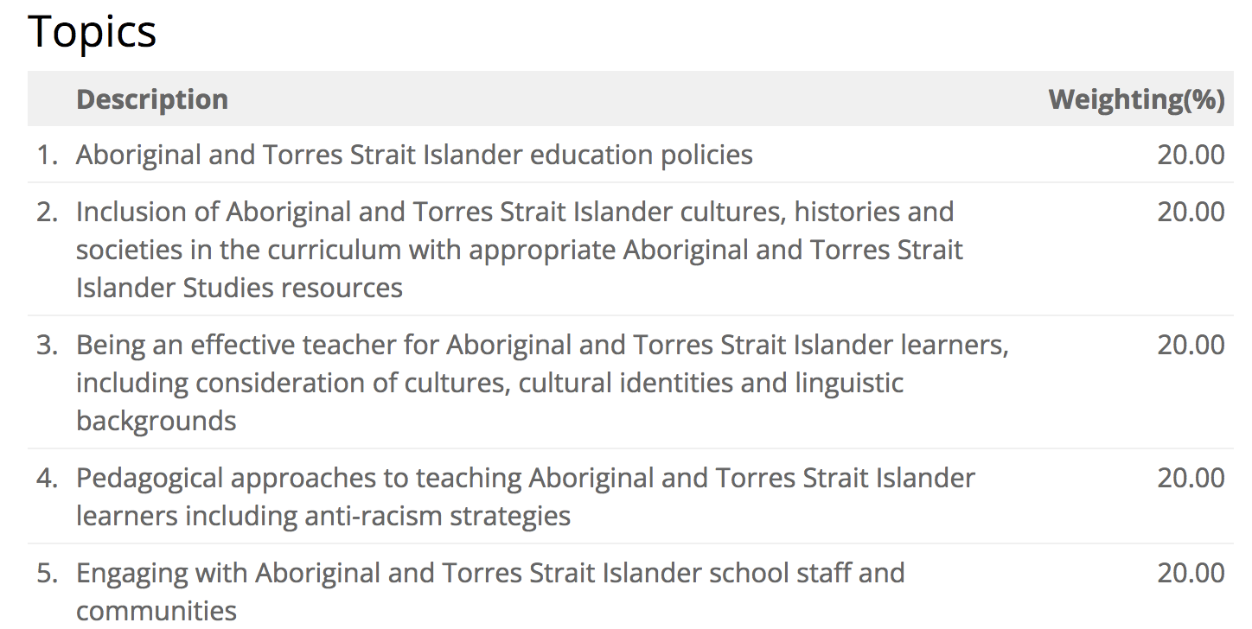
Course topics

Slide 20
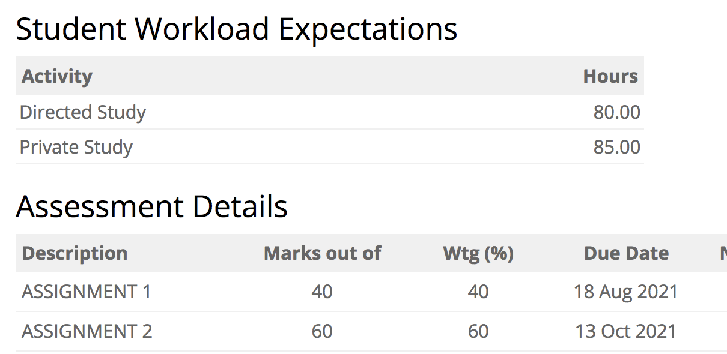
Assessment –weightings and study time

Slide 21
Assessment task
1. Essay to discuss policy issues.
2. Develop a lesson plan to show how Indigenous ways of learning can be applied – flexibility to choose student year level and subject e.g. Science, English, Mathematics.
Each assignment is set to meet course objectives that link to National Professional Standards for Teachers.

Slide 22
Open to questions

Slide 23
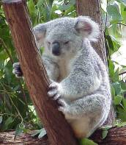
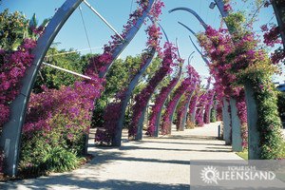
Thank you

